Slide 1
AI TOOL for early stage dementia detection
CSE7302- Internship / University Project Reviews
Review-2
Batch Number : CSE-176
Under the Supervision of,
Roll Number | Student Name
20221CSE0268 | PIRUTHVIRAJ S
20221CSE0270 | RAFAEL V
20221CSE0260 | REVANTH ADITHYA V
Ms. Saiqa Khan N
Assistant Professor
School of Computer Science Engineering
Presidency University
Name of the Program : Computer Science and Engineering
Name of the HoD : Dr. Asif Mohammed
Name of the Program Project Coordinator : Dr. Muthuraj
Name of the School Project Coordinators : Dr. Sampath A K , Dr. Geetha A

Slide 2
Problem Statement Number
Early detection of dementia is challenging due to subtle symptoms, time-consuming clinical tests, and lack of accessible diagnostic tools. Traditional diagnosis relies heavily on expert evaluation, which is costly and not scalable. There is a need for an intelligent, automated, and reliable system that can assist in early-stage dementia screening using AI techniques.

Slide 3
Content
Abstract
Literature Survey
Objectives
Existing Methods and Drawbacks
Proposed Method and Feasibility Study
Architecture Diagram
Modules Description

Slide 4
Content
Hardware and Software Details
Github
Timeline (GANTT CHART)
Future Enhancement
Conclusion
References

Slide 5
Abstract
Dimensional AI is an AI-driven system designed to assist in the early detection of dementia using multi-dimensional data such as speech patterns, cognitive test scores, and behavioral indicators. The system leverages machine learning models to identify subtle cognitive decline that is often missed in early clinical diagnosis. By providing quick, non-invasive, and scalable screening support, Dimensional AI aims to help clinicians, caregivers, and patients take early preventive actions. The proposed system focuses on accuracy, accessibility, and real-time analysis to improve diagnostic support and long-term patient outcomes.

Slide 6
Literature Survey
[1] A. Vasquez et al., “Early detection of dementia using machine learning techniques,” 2023 – Reviews how ML models analyze cognitive and behavioral data to identify early-stage dementia, highlighting improved diagnostic accuracy compared to traditional methods.
[2] J. Fraser et al., “Speech-based biomarkers for Alzheimer’s disease detection,” 2024 – Explores the use of speech patterns such as pauses, pitch variation, and fluency as reliable indicators for detecting cognitive decline using AI models.
[3] M. Liu and K. Patel, “Deep learning approaches for neurodegenerative disease diagnosis,” 2025 – Empirical study demonstrating how deep learning models outperform classical algorithms in identifying dementia from multi-dimensional medical datasets.
[4] S. R. Kumar et al., “Artificial intelligence in early dementia screening: Challenges and opportunities,” 2024 – Reviews AI adoption in healthcare screening systems, emphasizing scalability, non-invasive diagnosis, and ethical considerations.

Slide 7
Literature Survey
[5] R. A. Khan and S. Verma, “Machine learning approaches for early dementia diagnosis: A systematic review,” 2024 – Summarizes various ML techniques used for dementia detection, showing how feature selection and classification models improve early diagnosis accuracy.
[6] L. Hernández et al., “Speech and language processing for cognitive impairment detection,” 2023 – Reviews how natural language processing and speech analysis are used to identify linguistic markers associated with dementia and mild cognitive impairment.
[7] S. Sharma and P. Gupta, “AI-based healthcare decision support systems for neurodegenerative diseases,” 2025 – Analyzes the role of AI-driven decision support systems in assisting clinicians, highlighting improved reliability, speed, and scalability in dementia screening.
[8] World Health Organization (WHO), “Dementia: A public health priority,” 2023 – Reports on the global impact of dementia and emphasizes the need for early detection tools and technology-driven interventions to reduce disease progression and healthcare burden.

Slide 8
Literature Survey
[9] A. Erdmann and M. Ponzo, “SEO: The long-term strategy of organic keywords,” 2022 - Demonstrates SEO’s compounding benefits through long-term organic keyword strategies.
[10] G. A. Athaide and S. Moorman, “Marketing innovations and digital technologies,” 2025 - Conceptual review linking digital innovations with marketing practices, proposing future research agenda.

Slide 9
Objectives
Detect early signs of dementia using AI and data-driven analysis
Analyze speech, cognitive, and behavioral features
Improve diagnostic accuracy and speed
Provide a non-invasive and cost-effective screening tool
Support doctors and caregivers with AI-based insights

Slide 10
Existing Methods & Drawbacks
Existing Methods:
Manual cognitive tests
Clinical interviews and questionnaires
Brain imaging techniques (MRI, CT)
Expert-dependent diagnosis

Slide 11
Existing Methods & Drawbacks
Drawbacks and Limitations:
Time-consuming diagnosis
High dependency on specialists
Expensive medical tests
Late detection in many cases
Not scalable for large populations

Slide 12
Proposed Method & Feasibility Study
Dimensional AI uses machine learning models to analyze speech features, cognitive assessment data, and behavioral patterns. The system processes input data, extracts relevant features, and predicts dementia risk levels. Results are presented through a simple dashboard for medical interpretation.

Slide 13
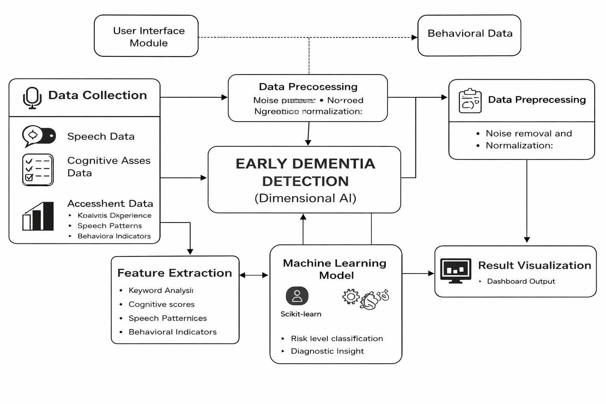
Architectural Diagram

Slide 14
Modules Description
Data Collection Module – Collects speech and cognitive data
Preprocessing Module – Noise removal and normalization
Feature Extraction Module – Extracts relevant indicators
ML Model Module – Trains and predicts dementia risk
Prediction Module – Outputs classification results
User Interface Module – Displays analysis and results

Slide 15
Hardware & Software Details
Hardware:
Laptop / PC
Internet Connection
Software:
Python
TensorFlow / Scikit-learn
Flask / Streamlit
Jupyter Notebook
Google Colab

Slide 16
Github Link
The Github link provided should have public access permission.
Github Link :
https://github.com/dexty8147/AI-TOOL-FOR-EARLY-STAGE-DIMENTIA-DETECTION.git

Slide 17
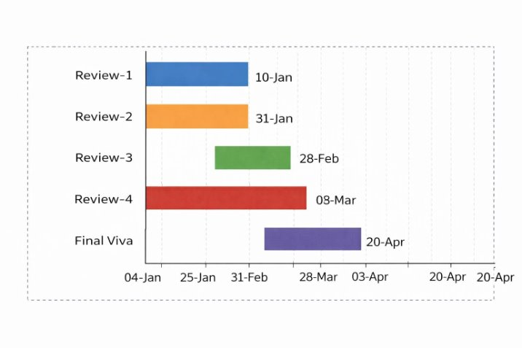
Timeline of the Project (Gantt Chart)
PHASE | ACTIVITY | START DATE | END DATE
Review-1 | Problem statement and objectives | 10-01-2026 | 16-01-2026
Review-2 | Literature review and model design | 31-01-2026 | 06-02-2026
Review-3 | Development and progress | 28-02-2026 | 06-03-2026
Review-4 | Testing and final progress | 03-04-2026 | 09-04-2026
Final Viva | Submission and viva | 20-04-2026 | 26-04-2026

Slide 18
Future Enhancements
Integration with mobile application
Real-time speech analysis
Improved deep learning models
Multilingual support
Clinical validation

Slide 19
Conclusion
Dimensional AI provides an intelligent, scalable, and efficient solution for early dementia detection. By leveraging AI and machine learning, the system enhances diagnostic support, reduces delays, and improves healthcare outcomes. The project demonstrates the potential of AI in preventive healthcare applications.

Slide 20
References (IEEE Paper format)
[1]. World Health Organization (WHO), “Dementia – Key Facts,” WHO, 2023.
https://www.who.int/news-room/fact-sheets/detail/dementia
[2]. Alzheimer’s Association, “What Is Dementia?,” Alzheimer’s Association, 2024.
https://www.alz.org/alzheimers-dementia/what-is-dementia
[3]. M. Gauthier et al., “Artificial Intelligence in Early Detection of Dementia,” Journal of Medical Systems, vol. 45, no. 3, 2021.
[4]. A. Fraser et al., “Detecting Cognitive Decline Using Speech and Language Analysis,” IEEE Journal of
Biomedical and Health Informatics, 2020.
[5]. Scikit-learn Developers, “Machine Learning in Python,” Scikit-learn Documentation. https://scikit-learn.org
[6]. TensorFlow, “An End-to-End Open Source Machine Learning Platform,” TensorFlow.org.
https://www.tensorflow.org

Slide 21
References (IEEE Paper format)
[7]. Librosa Developers, “Librosa: Audio and Music Signal Analysis in Python,” Librosa Documentation.https://librosa.org
[8]. Google Research, “Speech Recognition and Cognitive Analysis Using AI,” Google AI Blog.https://ai.googleblog.com
[9]. ChatGPT, OpenAI, “AI-assisted Research and Content Generation Tool,” OpenAI.https://www.openai.com
[10]. Petersen, R. C., “Early Diagnosis of Alzheimer’s Disease: Is MCI Too Late?,” Current Alzheimer Research, vol. 6,no. 4, pp. 324–330, 2009.
[11]. Jack, C. R. et al., “NIA-AA Research Framework: Toward a Biological Definition of Alzheimer’s Disease,”Alzheimer’s & Dementia, vol. 14, no. 4, pp. 535–562, 2018.
[12]. Shah, S. et al., “A Survey on Machine Learning Techniques for Dementia Detection,” Computer Methods andPrograms in Biomedicine, vol. 189, 2020.
[13]. López-de-Ipiña, K. et al., “Analysis of Speech and Language for Early Detection of Alzheimer’s Disease,”Neurocomputing, vol. 150, pp. 392–402, 2015.

Slide 22
[14]. World Alzheimer Report 2023, “Reducing Dementia Risk: Never Too Early, Never Too Late,” Alzheimer’s DiseaseInternational (ADI).
[15]. Esteva, A. et al., “A Guide to Deep Learning in Healthcare,” Nature Medicine, vol. 25, pp. 24–29, 2019.

Slide 23


